Slide 1
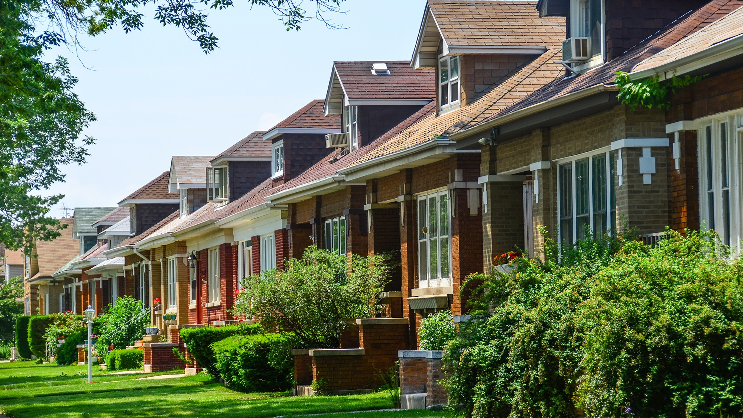
How Does Crime Affect Housing Prices?
Mentors: Professor Hornsten and Professor Ogawa
Posner Fellowship Program
By Aaron Castillo

Slide 2
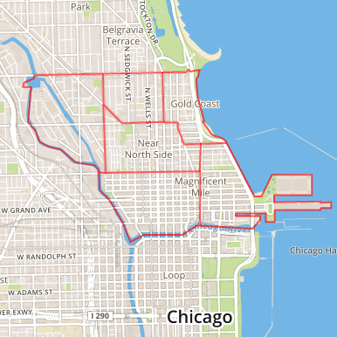
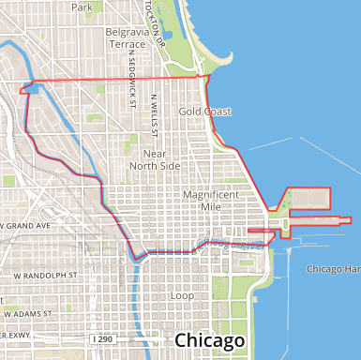
Data Collection Methods
Zillow Research
Data Type: Median Home Value per Square Foot
Geography: Neighborhoods
Time Frame: Monthly, 1996-Present
Chicago Data Portal (CLEAR system)
Data Type: Reported Incidents of Crime in Chicago (FBI Code Crime Classification)
Geography: Community Area
Chicago Metropolitan Agency for Planning
Time Frame: Daily, 2001-Present
Data Type: Demographics
Geography: Community Area
Time Frame: 2015
Community Area
Near North Side
Neighborhoods
Gold Coast
Old Town
River North
Streeterville

Slide 3
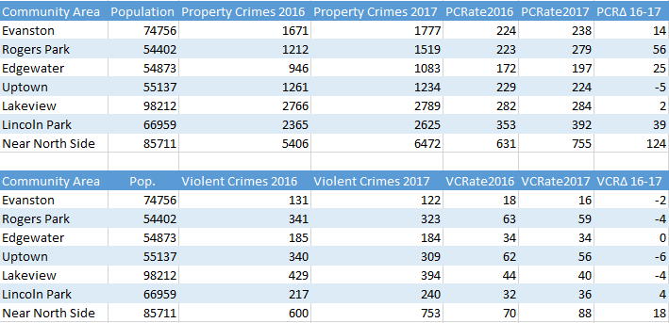

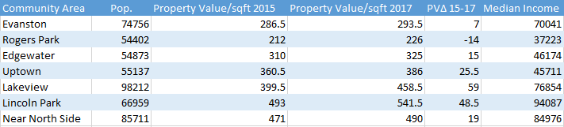
Property Crime – Burglary, Theft, Motor Vehicle Theft, Arson
Violent Crime - Homicide, Criminal Sexual Assault, Robbery, Aggravated Assault and Battery
Crime Rate – Crimes per 10,000 People
Δ – Change

Slide 4
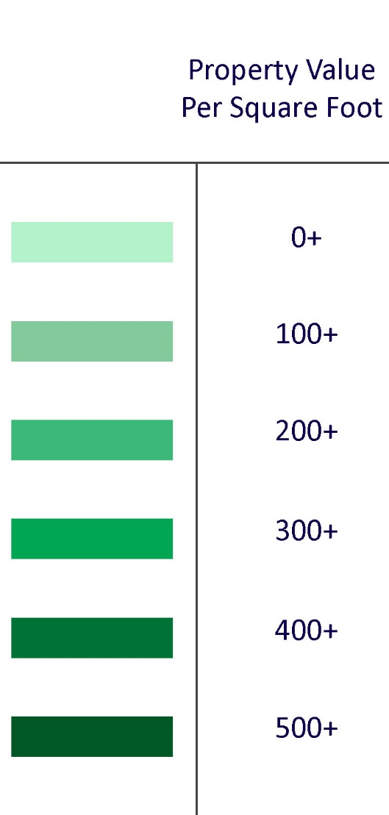
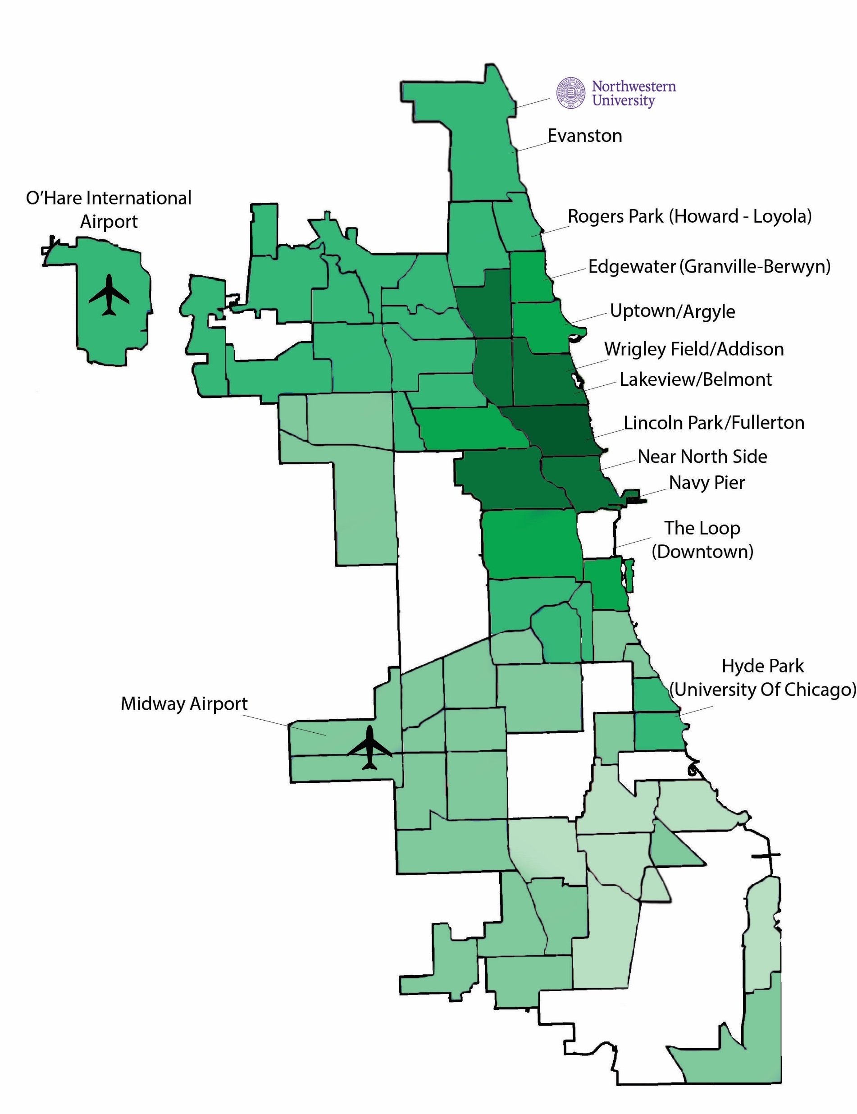
Note: Although Evanston is not a part of the city of Chicago, it has been added into data analysis

Slide 5
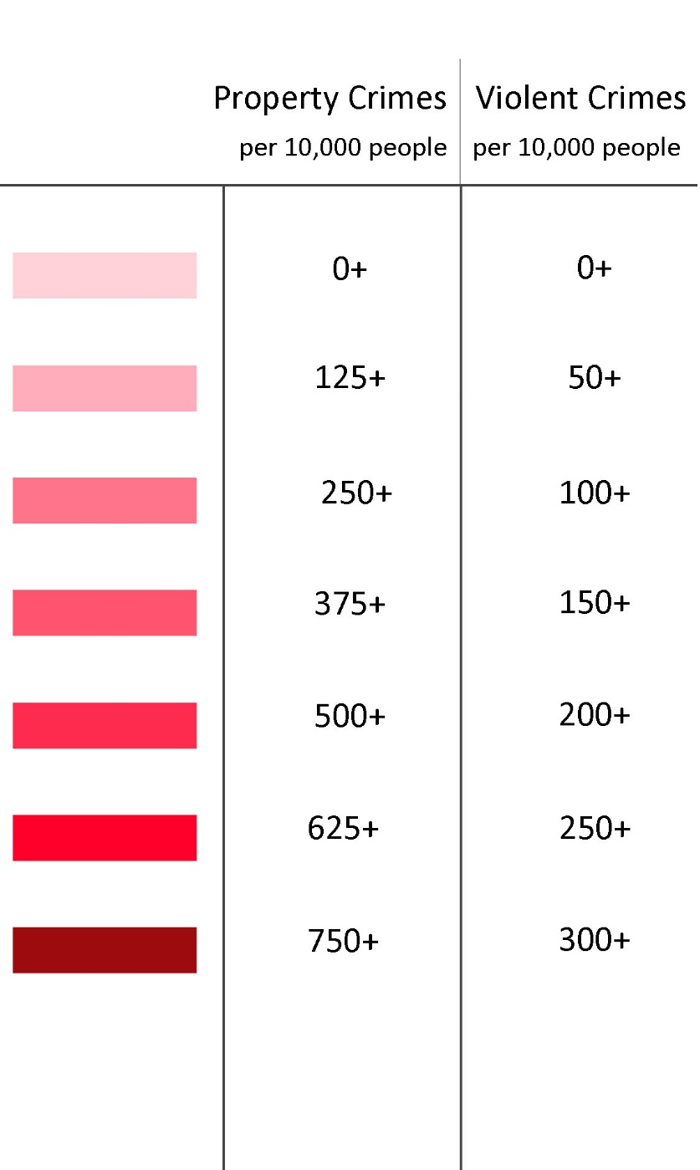
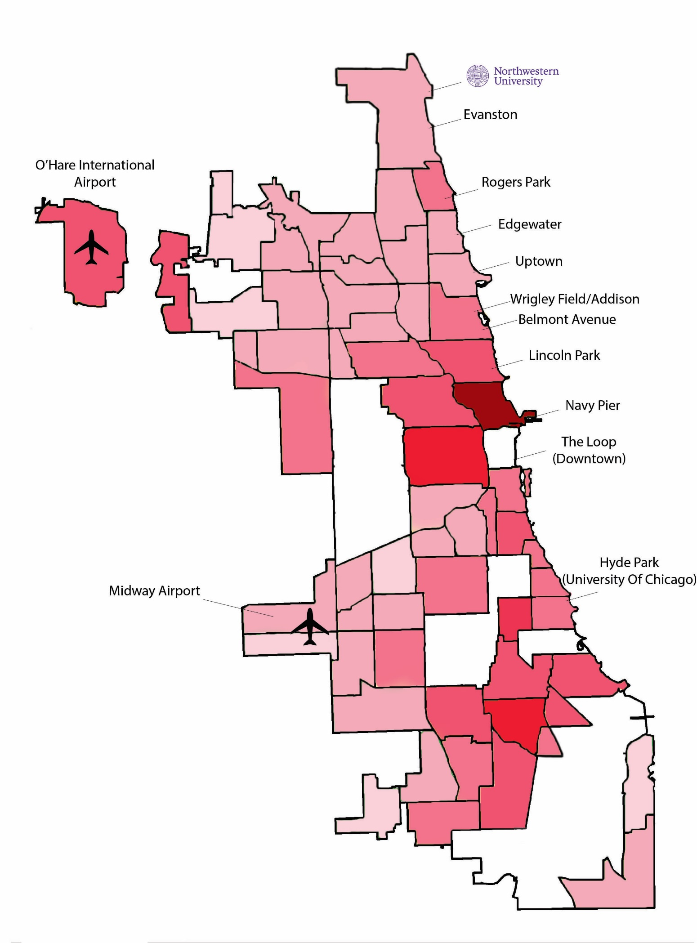
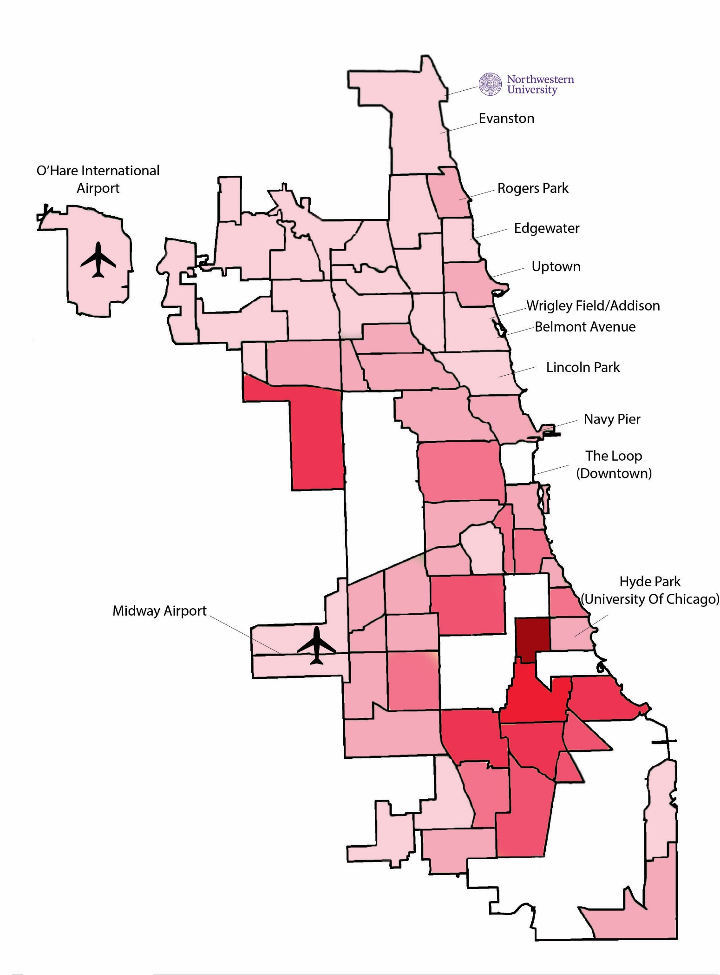
Property Crime Map
Violent Crime Map
Chicago Average: 277
National Average: 245
Chicago Average: 82
National Average: 39

Slide 6
Each additional property crime increases property value by $0.60/sqft
Each additional violent crime reduces property value by $1.50/sqft
The Effect of Levels of Crime on Property Value
Data Analysis Results
 | Property Values 2017
# of Property Crimes 2017 | 0.6
# of Violent Crimes 2017 | -1.5
Constant | 186.8
Observations | 61

Slide 7
Each additional property crime increases property value by $0.40/sqft
Each additional violent crime reduces property value by $1.00/sqft
The Effect of Levels of Crime on Property Value Controlling for Income
What is Going On?
Why does income affect the magnitude of crime’s effect?
Median income has an impact on property values as well
Context
Median size of a single family housing unit: 2426 square feet
Data Analysis Results
 | Property Values 2017
# of Property Crimes 2017 | 0.4
# of Violent Crimes 2017 | -1
Constant | 78.4
Observations | 61
0.4 $/sqft
2426 sqft
$970.6
-1 $/sqft
2426 sqft
$-2426.6

Slide 8
Each additional property crime increases the change in property value by $0.20/sqft
Each additional violent crime reduces the change in property value by $0.20/sqft
The Effect of Changes of Crime on Changes in Property Value
Why is there a mismatch in years?
The housing market doesn’t immediately respond to changes in crime. To capture full effect, I analyzed changes for 2015-2017.
Data Analysis Results
 | Change in Property Values 15-17
Change in Property Crimes 15-16 | 0.2
Change in Violent Crimes 15-16 | -0.2
Constant | 22.2
Observations | 61
Context
0.2 $/sqft
2426 sqft
$485.2
+1 Property Crime = Increase of $485.2
+1 Violent Crime = Decrease of $485.2

Slide 9

Future Directions
Can I fix the sources of error present in my process?
  Why is property crime positive?
  Find missing data
  Add more controls
What is the effect of individual crime categories on property value
  Murder, Theft, etc.
How do my results compare to other cities in the U.S?

Slide 10

How does crime affect housing prices across the U.S?
An Intercity Analysis

Slide 11
Data Sample
City | Property Crime Rate per 100,000 | Violent Crime Rate per 100,000 | Median Property Value per Square Foot
New York | 1.46 | 0.57 | 480
Los Angeles | 2.47 | .72 | 421.5
Chicago | 3.19 | 1.11 | 160.5
Notes:
Uniform Crime Reporting Program
Same crimes as intracity
Per 100,000 was more appropriate due to population sizes for cities

Slide 12
Regression Results
 | Media House Value per Square Foot
Property Crime Rate | -.009
 | (.02)
Violent Crime Rate | -.055
 | (.04)
Constant | 258.74
n | 96

Slide 13
Thank You!
Any Questions?

Slide 14
Appendix

Slide 15
Results
Notes:
Focus on the first two columns of your big regression table. For the first once, include some sort of relevant scatter plot. A cogent discussion of how and why the 1.4 coefficient becomes 1.0 (when income is added as a control) would be fantastic. You don't have to ever use the jargon "ommitted variable bias", but that is what it will be all about
Mention bias
CONTEXTUALIZE

Slide 16


Property Crime
Burglary
Larceny
Motor Vehicle Theft
Arson

Slide 17

Violent Crime
Homicide 1st and 2nd degree
Criminal Sexual Assault
Robbery
Aggravated Assault
Aggravated Battery

Slide 18
Notes:
THERE IS SOME VARIANCE
Correlation of .68
For every violent crime there are 1.33 property crimes
There are low property crime and low violent crime areas
“” “ high property crime and high violent crime areas
“ “ low violent crime and high property crime areas
No such thing as low property crime and high violent crime areas
What are these exceptions are Near North Side (Gold Coast (upscale boutiques and shops, home to the super rich, dealerships, high end restaurants), river north, streeterville, magmile), Near West side (United Center, west loop, little Italy, greektown), Chatham, West Town (Bucktown wicker park) (Washingtown Park and Greater Grand Crossing OHare (douglas and South shore) Lincoln Park
(gentrification? Highly commercial ares that are hubs of employment)
MENTION NEAR NORTH SIDE

Slide 19
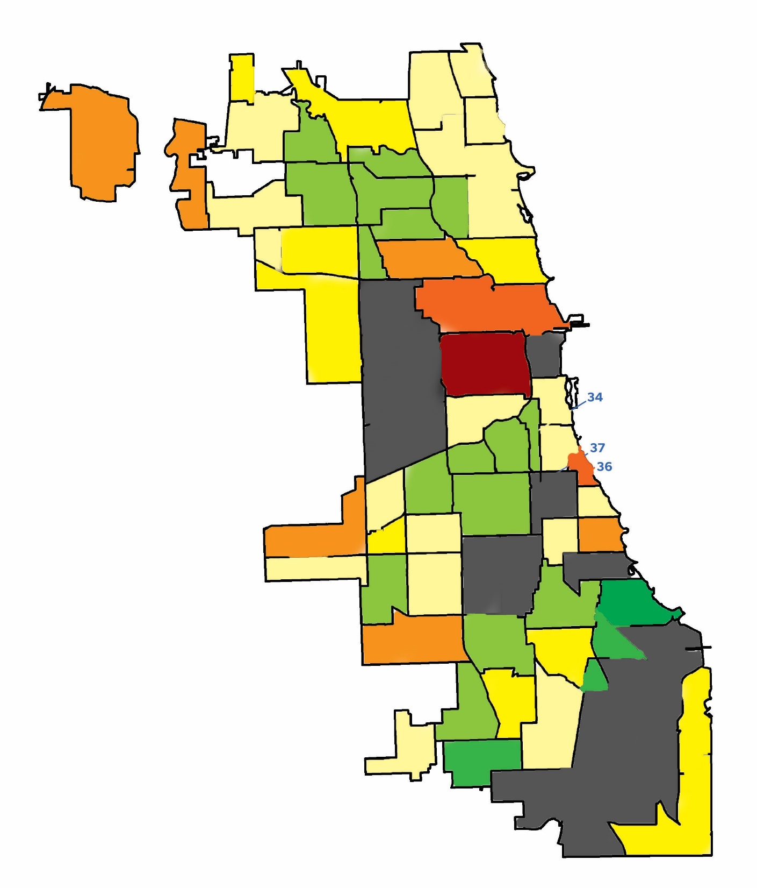
>125
100 – 125
75 - 100
50 to 75
25 to 50
0 to 25
-25 to 0
-50 to -25
< -50
Change in Property Crimes per 10,000 for 2015-2016
Mean: 16.33
Notes:
Seeing as I have been doing research on the effects of crime levels in Chicago on property values, it makes sense to get an idea of the crime situation within Chicago in the past few years.
While Chicago has always been know to be a crime ridden city, the events of 2014,, 15, and 16 resulted in changes within the police system of Chicago. Partly due to the Laquan mcdonald case in 14-15, which resulted in a series of protests, brought some changes. An increase in documentation during stops might have decreased the amount of police street stops in Chicago. While the reason for the spike in crimes isn’t clear, it has affects on property values. My goal was to see what types of changes occurred in my categories of interest and to see if there was any intereting relationships.
Goal: where spikes were and if there is anything unique ab them or is it random. Also see if there is a relation between property jumps and violent jumps.
Low quality
No Evanston
Add missing 17 community areas?
Fix Green
Mean: Change of 16.33 crimes per 10,000
Min: -65.30
Max: 155.26
Median: 13.60
What do these maps show?
15-16 had a large increase across both crimes
Gives an idea geographically of what is going on across the city
Affected both sides equally, could make an argument that it affected north side there are darker shades
Where?
High crime areas werent necessarily increase
QUICK GRAPH OF SPIKE

Slide 20
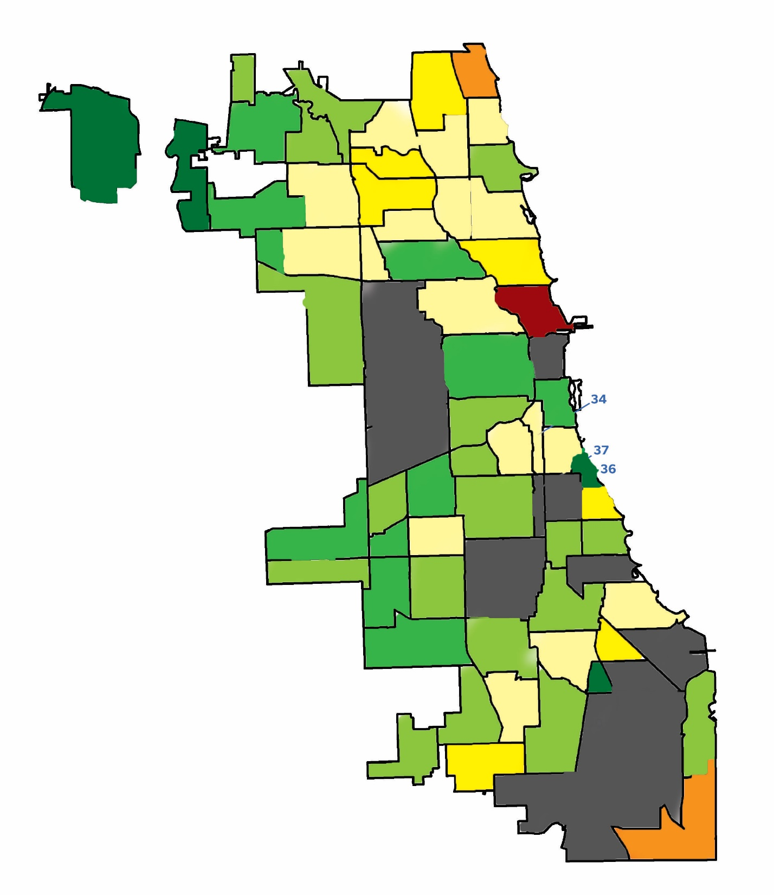
>125
100 – 125
75 - 100
50 to 75
25 to 50
0 to 25
-25 to 0
-50 to -25
< -50
Change in Property Crimes per 10,000 for 2016-2017
Mean: -2.14
Notes:
Low quality
No Evanston
Add missing 17 community areas?
Mean: Change of -2.14
Min -87.20
Max 124.37
Median -4.9

Slide 21
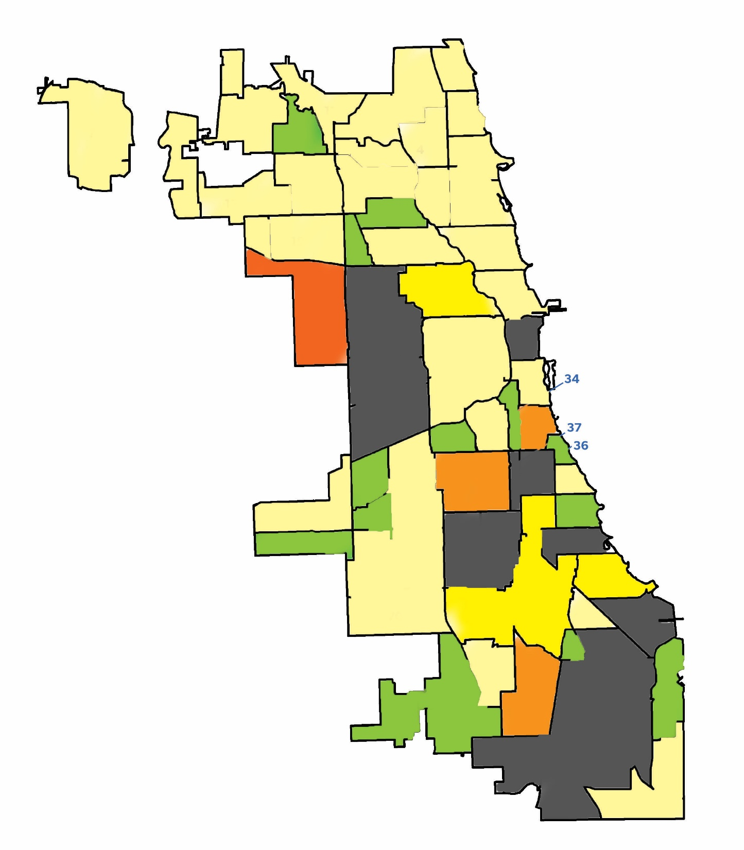
>125
100 – 125
75 - 100
50 to 75
25 to 50
0 to 25
-25 to 0
-50 to -25
< -50
Change in Violent Crimes per 10,000 for 2015-2016
Mean: 12.61
Notes:
Low quality
No Evanston
Add missing 17 community areas?
Mean 12.61
Min -15.38
Max 97.09
Median 8.15
Affected both north and south side equally
No preference towards downtown or not
Where?
IN PROPORTIONS (maybe)

Slide 22
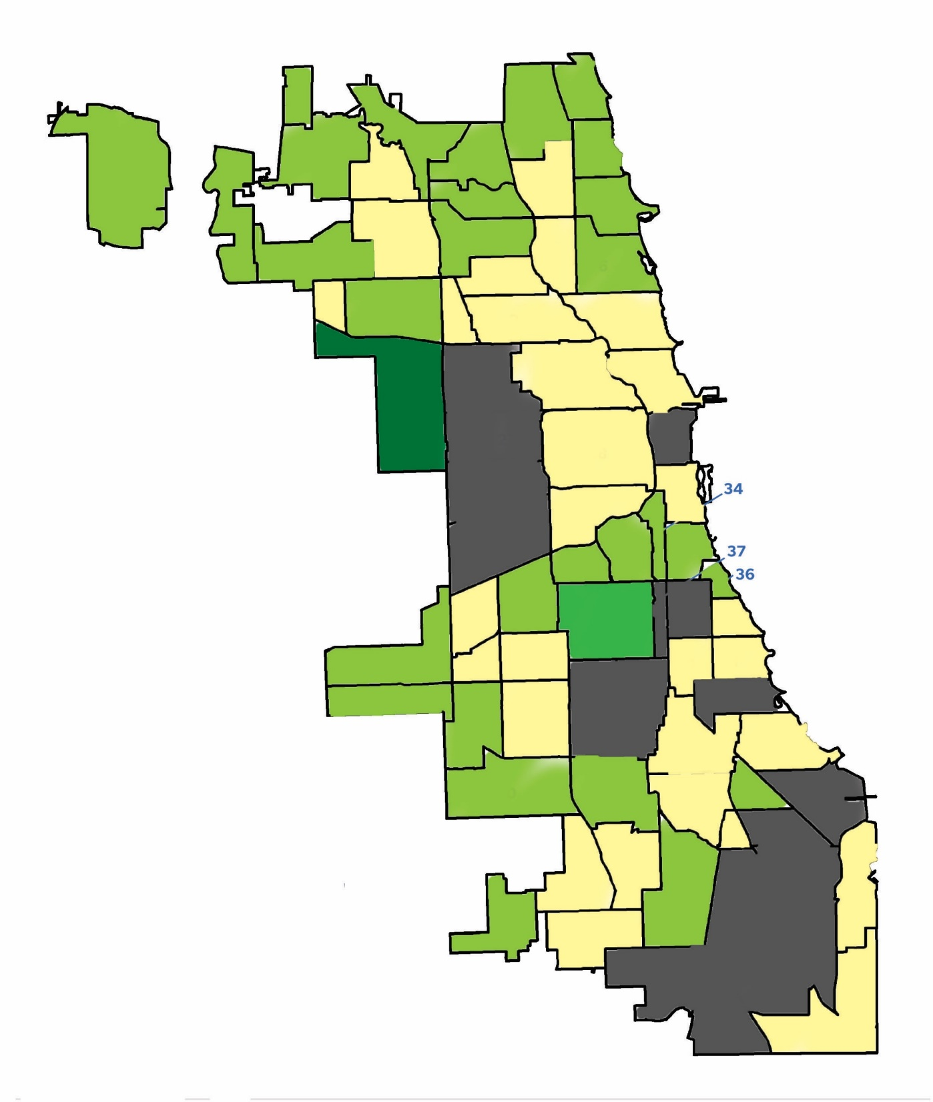
>125
100 – 125
75 - 100
50 to 75
25 to 50
0 to 25
-25 to 0
-50 to -25
< -50
Change in Violent Crimes per 10,000 for 2016-2017
Mean: -0.3
Notes:
Mean 0.3
Min -71.18
Max 23.71
Median 0
No clear pattern from looking at maps
How correlated are jumps across areas
Scatterplot on Jumps

Slide 23
Works cited

