Slide 1
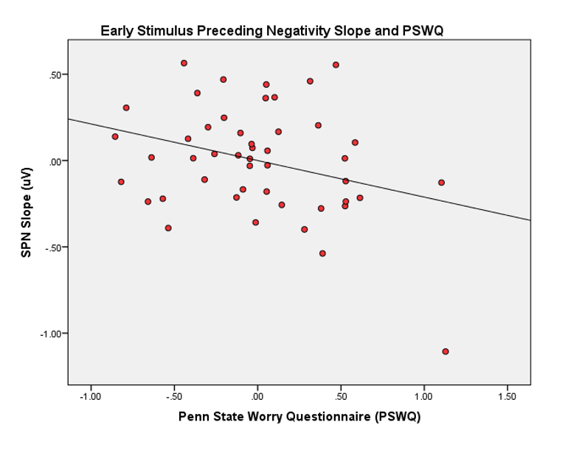
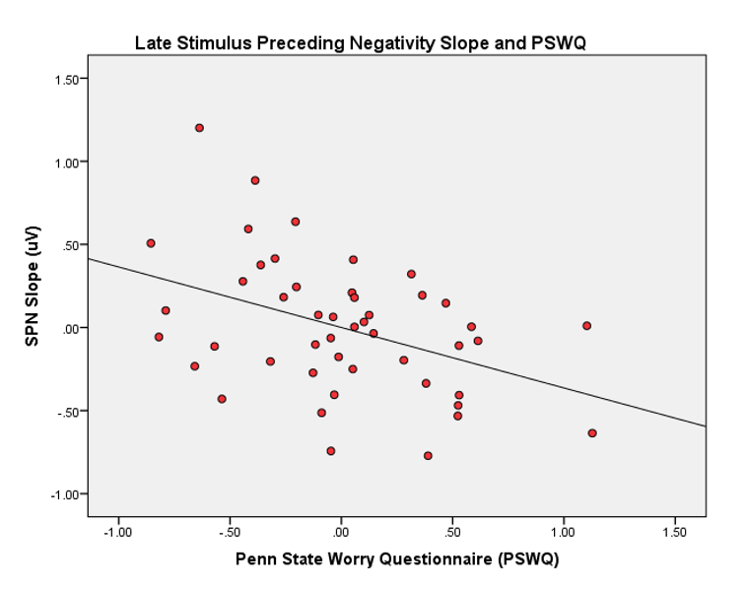
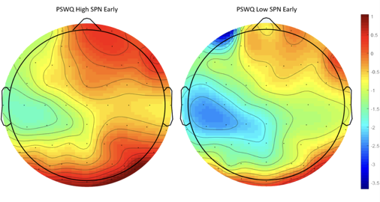
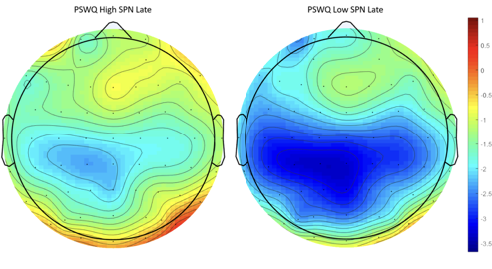
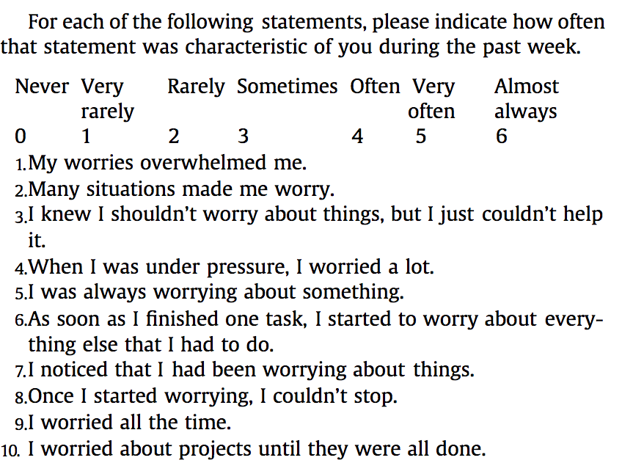
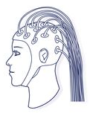
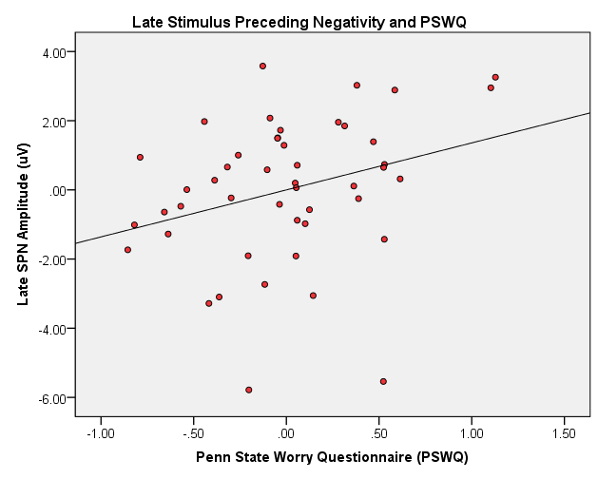
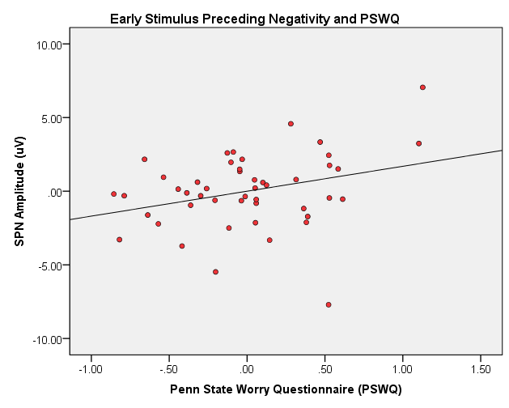
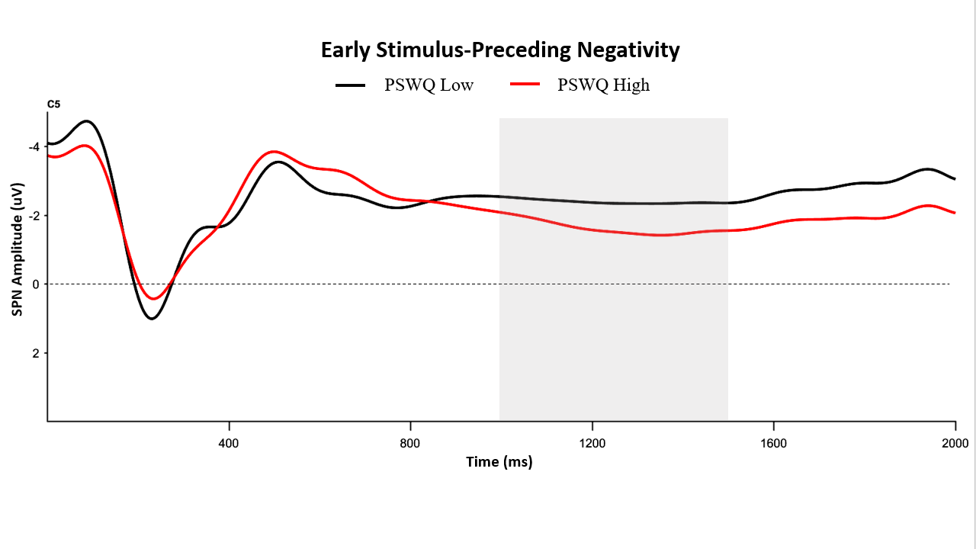
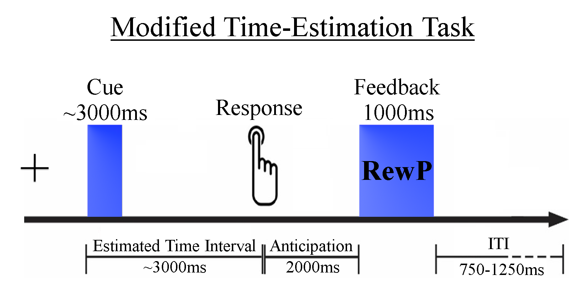
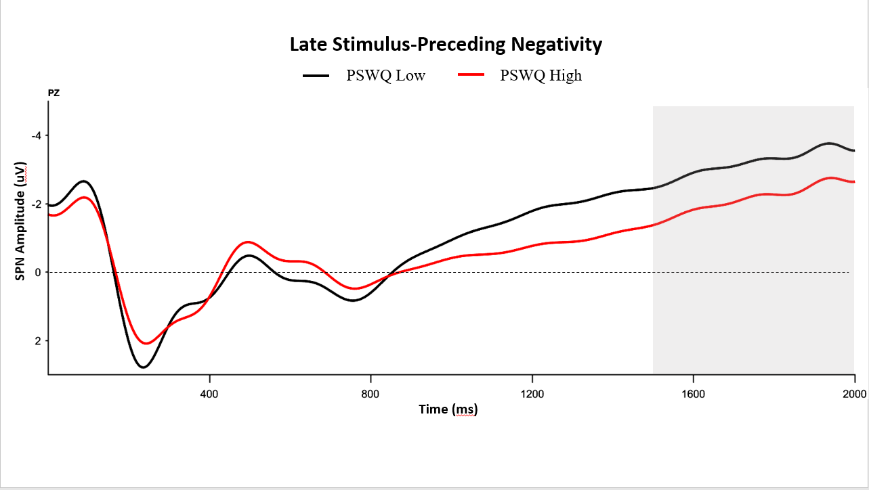
Uncovering Neural Correlates of Anxious-Apprehension in Anticipation of Rewards
Andrew R. Kittleson¹, James E. Glazer², and C. Robin Nusslock^{1,2}
Departments of ¹Neurobiology and ²Psychology, Northwestern University, Evanston, IL
Percent
anxious-apprehension was significantly predictive of Early (B = .35, p = .042) and Late SPN amplitude (B = .34, p = .048)
Results
Introduction
Objectives
Results
Diagnosis and treatment of anxiety disorders
Electroencephalogram (EEG) provides a reliable, low-cost method for identifying biomarkers of risk for anxiety disorder development
Here, I investigated the stimulus-preceding negativity (SPN) in a population of undergraduates to understand how chronic cognitive worry may be associated with processes underlying reward-anticipation
Scalp map analysis of the SPN revealed two spatially and temporally distinguishable components across all participants, regardless of anxiety symptoms
Immediate reward-anticipation elicited a more negative (enhanced) SPN slope than delayed reward-anticipation
Currently, 18.1% of the population of the United states has some form of anxiety disorder.¹ Methods for diagnosis and treatment of anxiety disorders are lacking
Symptoms of anxiety disorders can be broken into two main dimensions that are distinguishable physiologically and behaviorally²
Anxious-apprehension is characterized by cognitive components of worry and excessive or intrusive fretting³
Anxious-arousal is characterized by increase in physical arousal and heightened activity of threat-detection systems³
Biomarkers can be especially beneficial for identifying risk of development for anxiety disorders—noninvasive methods like electroencephalogram (EEG) are ideal
Event-related potentials (ERPs) recorded from EEG are useful in identifying individual differences in neural processes and can be used to predict risk of anxiety disorder development
The Early SPN [left pair] from 1000-500 ms was maximal in centro-temporal regions, and the Late SPN [right pair] from 500-0 ms was maximal in central parietal regions. Each pair of scalp maps shows high PSWQ scorers [left] and low PSWQ scorers [right] for Early and Late SPN components.
For both Early and Late SPN components, PSWQ self-report scores were positively correlated with peak amplitudes
Plots of SPN slope versus anxious-apprehension are shown at top. Slope of Early SPN was negatively correlated with higher PSWQ sums (B = -.38, p = .041) [top left]. Slope of the Late SPN was negatively correlated with higher PSWQ sums (B = -.46, p < .01) [top right].
Rates of delay discounting in Low (black) and High (red) PSWQ scorers are shown at bottom. Rate of discounting for Low scorers trended towards decreasing in Early SPN (B = -.337, p = .041) [bottom left]. Rate of discounting for Low scorers similarly decreased with time (B = -.459, p = .005) [bottom right]. High PSWQ scorers did not show this decrease in discounting over time for either SPN component.
Right-handed Northwestern undergraduate participants completed surveys and an electroencephalogram (EEG) task. Correlations of chronic worry and an anticipatory event-related potential (ERP) were analyzed. Previous work has sought to understand anxious-apprehension in anticipation of errors, but not in reward-anticipation. The present study aimed to identify how anxious-apprehension can affect reward-anticipation, indexed by this ERP of interest.
Error-Processing and Reward-Processing in Anxiety Disorders
Anxiety has often been studied in the context of aversive responses like losses and errors. In contrast, far fewer studies have tried to understand the role of anxiety in reward-processing
Scatterplots correlations between PSWQ scores and both Early and Late SPN peak amplitude. Anxious-apprehension was significantly predictive of Early (B = .35, p = .042) and Late SPN amplitude (B = .34, p = .048).
Conclusions
Methodology
Anxious-apprehension, indexed by scores on the PSWQ, was associated with a heightened SPN amplitude prior to reward feedback after controlling for confounds.
Anxious-apprehension was related to the SPN slope (the rate of change from more immediate to more distant rewards)
While SPN amplitude trended toward attenuation as rewards became more distant in the future, individuals with more chronic worry tended to display less attenuation regardless of reward delay.
Early and Late SPN waveforms demonstrate blunting in high PSWQ scorers
Participants (N = 47) completed the Penn State Worry Questionnaire (PSWQ) and a Time Estimation EEG paradigm to study anxious-apprehension and reward-anticipation
Elevated neural activity during error-processing is most strongly associated with anxious-apprehension, with little or no relation to anxious-arousal⁴
Penn State Worry Questionnaire (PSWQ) provides a valid index of anxious-apprehension symptoms
The stimulus-preceding negativity (SPN) is an anticipatory ERP that indexes neural efficiency and focus on a given task⁵
SPN in reward-processing could provide a new way of identifying risk for anxiety disorder development
Future Directions
Utilize more diverse samples to study possible interaction(s) of mental illness and reward-anticipation in the general population
Determine alternate pathways through which reward-anticipation and symptoms of anxiety interact besides decreased neural efficiency, using genetic analyses and MRI
References
Progression of a single trial in the Time Estimation paradigm utilized. Participants were asked to estimate 3.5 seconds and then press a response key when a Cue was displayed for 300 ms. An adaptive algorithm allowed participants to win ~67% of all trials by increasing or decreasing the window for correct responses. SPN was elicited and recorded in the 1000 ms leading up to Feedback. ITI = inter-trial interval.
1. Anxiety and Depression Association of America, 2016
2. Nitschke, 1999
3. Simons, 2010 & Hajcak et al., 2003a
4. Moser et. al., 2013
5. Brunia, 1988, & Kotani et. al., 2008
Acknowledgments
Average waveforms at C5 for Early SPN [top] and at Pz for Late SPN [bottom]. Time windows of interest for both waveforms are highlighted.
This work was funded by _____.

