Slide 1

MPES Practicum: Supporting Phase II of
D65 Student Assignment
Nicole Guarino
June 7, 2023

Slide 2
Background
Notes:
Background/Introduction
Problem of practice addressed
Useful contextual information about your practice-side partner organization/program

Slide 3
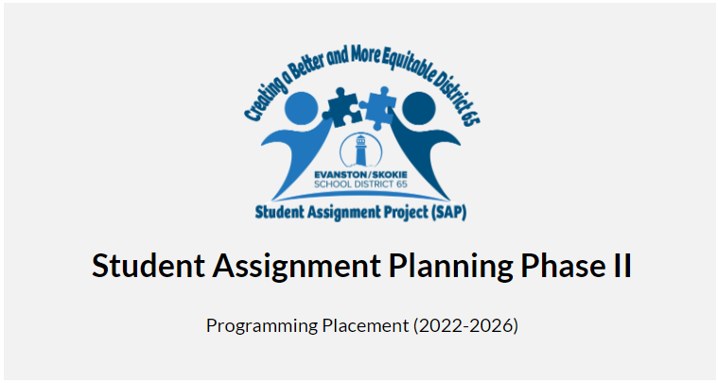
My MPES Practicum
With Sarita Smith, D65 Director of Student Assignments
Notes:
For my practicum, I supported data analysis and dissemination during Phase II of Student Assignment Planning in District 65, partnering with Sarita Smith, the Director of Student Assignments. Nichole Pinkard and Jana facilitated this relationship as they have provided ongoing support to D65 and Sarita for decision-making around schools in the district.

Slide 4
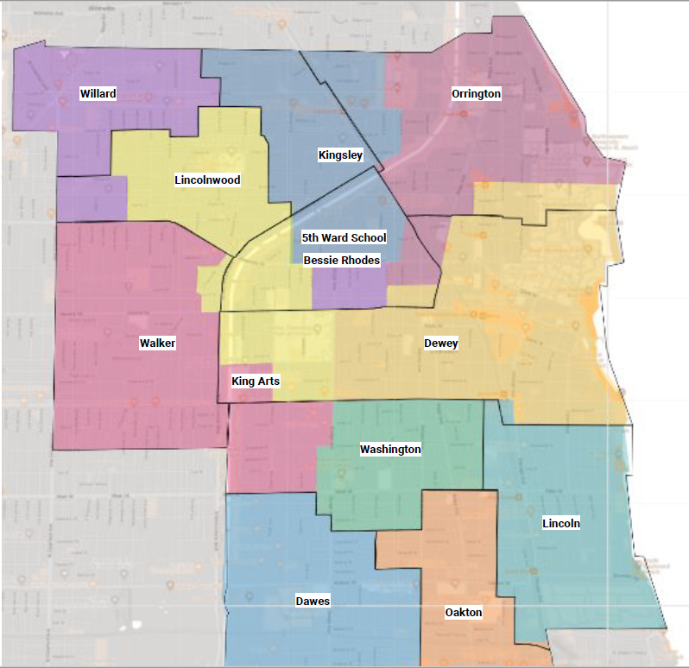
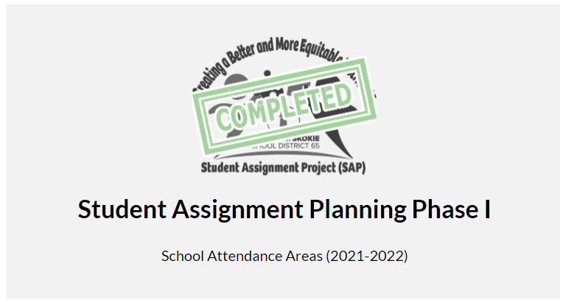
Notes:
You might remember Sarita from one of our MPES seminars from winter quarter, facilitated by Karla, Tre, and Lara. She and her panelists described the history of race and education in Evanston and the recent school board decision to place a new neighborhood K-8 school back in the Fifth Ward for the first time in several decades.
This was the culmination of work during Phase I of Student Assignment Planning. Sarita organized listening sessions with community members as part of the decision-making around how to deal with an impending budget crisis as well as addressing ongoing injustices toward Black students in the Fifth Ward who had been without a neighborhood school for generations. Overwhelmingly, the community supported neighborhood schools for all students, rebuffing decades of integration that fell on Black students from the Fifth Ward and saving the district millions in transportation costs. This data went to the SAP planning committee, who made recommendations to the school board. A new K-8 school in the Fifth Ward meant that the district had to draw new school boundaries. This map shows the approved elementary school boundaries for implementation in the 2025-26 school year (at the earliest).

Slide 5
Notes:
Now that decisions have been made around creating a Fifth Ward school and school boundaries have been redrawn, the district launched Phase II of Student Assignment Planning at the beginning of the academic year to tackle the reality of redrawn boundaries by asking whether school programs should move, remain, or come to an end when the student body changes. It also gives the district an opportunity to reexamine initiatives and programs already in place in the context of all the changes that will be happening at schools.

Slide 6
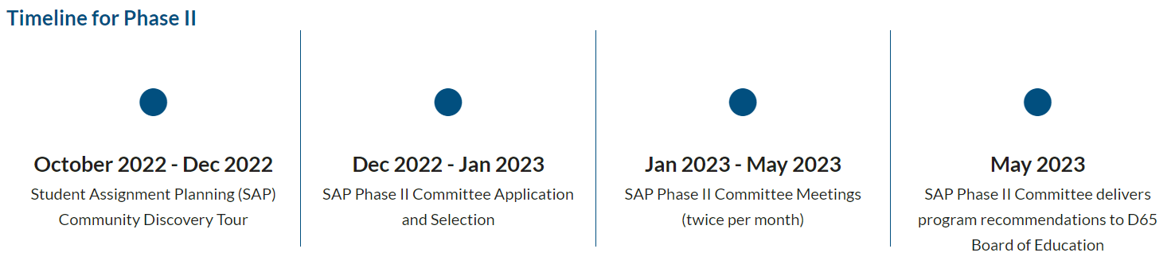
Notes:
Sarita collected community feedback on program topics at listening sessions called Discovery Tours and through other means from October through December. This data would inform the Phase II Student Advisory Planning Committee, who have the responsibility of making recommendations to the school board. They were chosen based on applications between December and January and met regarding the programs between February and May.

Slide 7
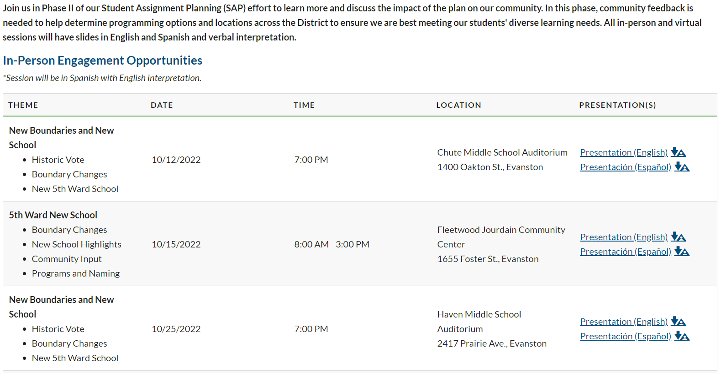
Notes:
This is a screenshot of the D65 website that announced the meeting dates, times, and locations. Each meeting focused on a single program topic, which I’ll describe in detail in a moment. Sarita facilitated each of these meetings. There were a total of 11 in-person meetings and 8 online meetings. Four meetings included Spanish interpretation on a topic of particular importance for Spanish-speaking families.

Slide 8


Notes:
During the presentations, Sarita asked participants to share their thoughts on specific questions using the ThoughtExchange platform. This is how meeting participants could share their thoughts anonymously. They also had the opportunity to rate other people’s comments through this system. The images here show slides that participants saw during meetings and how they could contribute to the ThoughtExchange. The participants also filled out demographic information that the ThoughtExchange system reported at an aggregate level so individual comments could not be identified.

Slide 9
Other data collection
Session for school staff
Summaries of meeting discussions
Student Advisory Committee open-ended responses
Soliciting responses after Fifth Ward Community meeting using social media
Notes:
This wasn’t the only way Sarita collected information from meetings. Sarita used flexible methods in order to capture people’s thoughts on programs, including writing summaries of discussions that occurred at Discovery Tours, collecting open-ended comments from a Student Advisory Committee, and soliciting community members to respond to questions following a large community meeting about the Fifth Ward school, where it was difficult to collect responses in the typical manner.

Slide 10
Programs and topics
Lingering boundary concerns
Fifth Ward school
Two-Way Immersion (TWI: Spanish/English bilingual program)
African Centered Curriculum (ACC @Oakton)
Magnet schools (K-8)
  King Arts
  Bessie Rhodes (TWI and moving to Fifth Ward School)
Specialty programs (e.g., students with significant disabilities)
Pre-K
Notes:
The district wanted to learn about the following programs and topics. I’m not going to describe the goals for each of these because it will take too long, but this gives you a sense of the kinds of programs the district wanted to hear about from their community members. For example, they wanted to know about how to improve African Centered Curriculum and whether to expand it from Oakton Elementary School and how to ensure the two-way bilingual Spanish immersion programs would meet the needs of the students the program intends to serve.
Specialty programs:
RISE at King Arts: self-contained, special education program which provides a supportive and rigorous educational experience for students who present with moderate to significant disabilities and require special education instruction for more than 50 percent of the school day. (https://www.district65.net/Page/2515)
Rice Children’s Center: Rice is a residential treatment center and school for kids between the ages of 8 and 15 who are experiencing severe emotional, behavioral or mental health needs. (https://evanstonroundtable.com/2023/01/04/a-glimpse-inside-rice-evanstons-own-residential-school/)
STEP: a self-contained, special education program primarily for students who have an Autism Spectrum Disorder. (https://www.district65.net/Page/2515)
Park School: a self-contained therapeutic public school day program for students having substantial physical and cognitive disabilities. (ages 3-21) (https://evanstonroundtable.com/2018/10/31/park-schools-playground-it-took-a-village/)

Slide 11
Methods & Procedures
Notes:
Methods/Procedures
Timeline of practicum activities
Details about what you did and how you did it
Be sure to include specific data collection, analysis and dissemination tasks, as well as interactions with your practice-side partner(s)

Slide 13
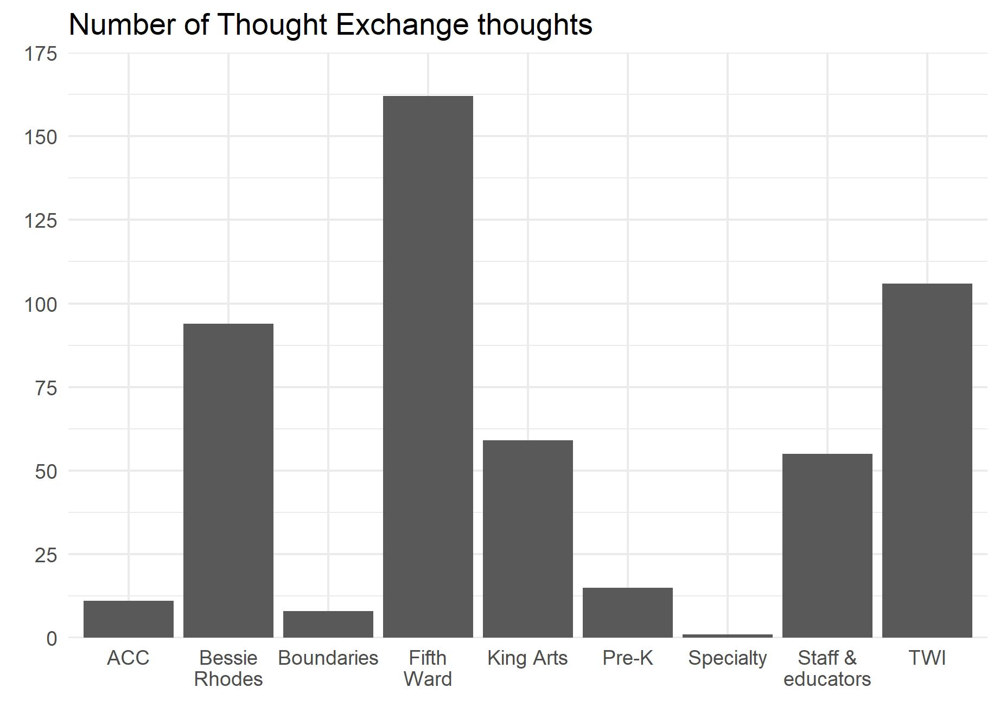
Notes:
Close to 450 thoughts gathered

Slide 14
Qualitative analysis
Consolidated data across meetings on the same topic and question
Loaded into Dedoose and coded as themes emerged (iterative)
Reviewed whether codes included quotes with a ~top third rated quote

Slide 15
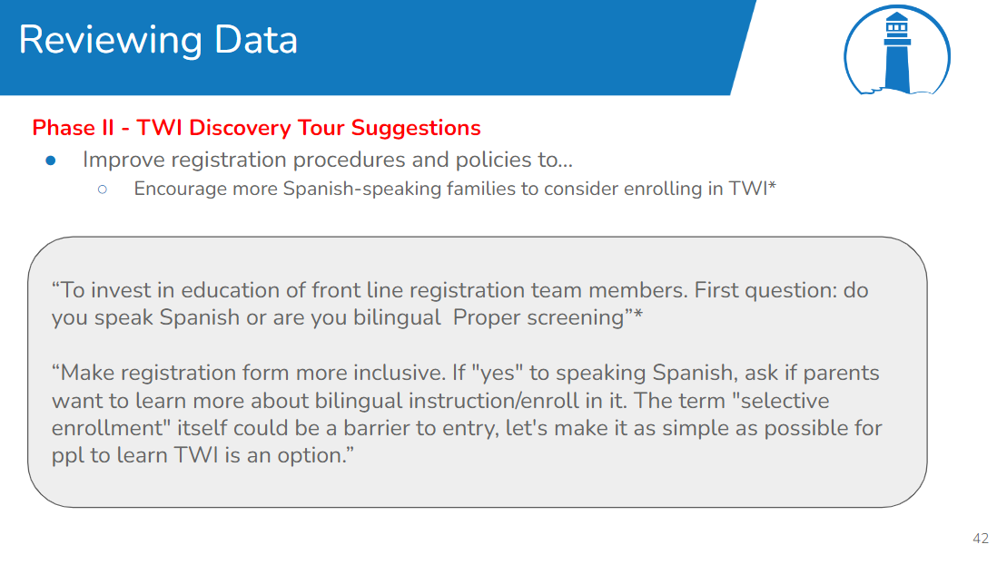

Slide 16
Quantitative analysis
Summarize number of participants, thoughts, and ratings across program topics
Summarize pertinent participant demographics by topic
Create visualizations (i.e., graphs) when useful

Slide 17
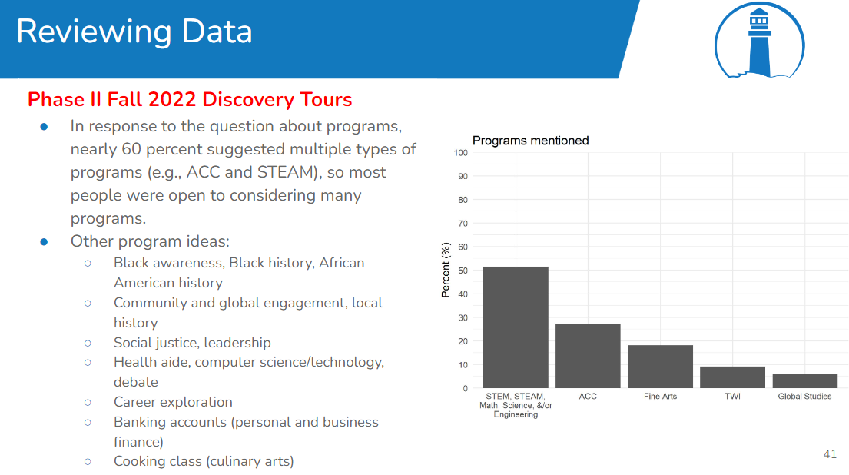

Slide 18
Dissemination
Slide deck by meeting focus (e.g., TWI)
  Reviewed meeting outline & goals with Sarita
  Populated slides with graphs, themes, and pertinent quotes based on data
  Discussed graphs, themes, and quotes with Sarita

Slide 19
Findings
Notes:
Findings/What You Learned
Related to problem of practice (e.g., findings, deliverables, next steps)
Related to collaborative research (e.g., benefits, challenges, areas of growth)

Slide 20
SAP findings
How to strengthen magnet schools (King Arts, Bessie Rhodes)
  D65
  Community
TWI tensions
Open possibilities for Fifth Ward School
ACC/pre-K/specials
Notes:
TWI tensions: trying to enroll students for whom TWI was designed to benefit and understand why some Spanish-speaking families do not opt into TWI; people concerned that TWI should serve their school for a variety of reasons (because there’s a Spanish-speaking population or because the district should prioritize serving other populations that the program is not designed for: balanced bilinguals or native English speakers who have been participating in TWI over the last several years)

Slide 21
Things I learned
Exciting to contribute to “sticky” problems of practice
Be flexible and open to changes
Be honest about what data can and cannot tell us
Rely on partner knowledge and expertise and ask questions
Write down methodology

